Slide 1


Rayhaan Dustagheer
21st May 2024

Slide 2

Outline
Executive Summary
Introduction
Methodology
Results
Conclusion
Appendix

Slide 3
Executive Summary
Summary of Methodologies:
This project follows the below mentioned steps:
Data collection and Data wrangling
Exploratory Data Analysis and Feature engineering
Data analytics through interactive visual analytics
Data modelling for Predictive Analysis (Classification)
Summary of Results:
Exploratory Data Analysis (EDA) results
Geospatial analysis and Interactive Dashboards
Predictive analysis through classification models

Slide 4
Introduction
SpaceX's Falcon 9 rockets are launched at a cost of approximately $62 million, significantly less expensive than other providers, whose costs typically exceed $165 million. A major factor in these savings is SpaceX's ability to land and reuse the rocket's first stage.
By predicting whether the first stage will successfully land, we can estimate the launch cost and use this information to evaluate if an alternative company should compete with SpaceX for a rocket launch contract.
The goal of this project is to predict whether the SpaceX Falcon 9 first stage will successfully land.

Slide 5

Section 1

Slide 6
Methodology
Data collection methodology:
Making GET requests to the SpaceX REST API
Web Scraping
Perform data wrangling
Using the .fillna() method to remove NaN values
Using the .value_counts() method to determine the following: Number of launches on each site, number and frequency of mission outcomes per orbit type, frequency of each orbit
Create an outcome of 0 when booster did not land successfully and an outcome of 1 when booster did land successfully

Slide 7
Methodology (continued)
Exploratory Data Analysis
Using sql to manipulate and query SpaceX dataset
For visualization of statistical graphs, Matplotlib and Pandas was used for pattern and relationship detection
Interactive Visual Analytics
Analyzed geospatial data using Folium and created interactive dashboard using Plotly Dash
Data Modelling and Evaluation
The dataset was preprocessed and standardized using Scikit-Learn library
The dataset was split into a test set, train set and validation set
4 models were used and the best hyperparameters for each model was determined using the GridSearch with Cross validation algorithm
The different models were trained, a confusion matrix for each model was plotted and the accuracy score of each model was calculated to determine the best performing model

Slide 8
Data Collection
Data for the Space X launches were collected using 2 main methods: Rest API and Web Scraping.
The data after being fetched from the Rest API were put in a Pandas Dataframe for further analysis
The other part of the dataset was obtained through web scraping and then the returned data was parse to extract data from tables present in the html page.

Slide 9
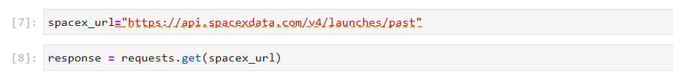
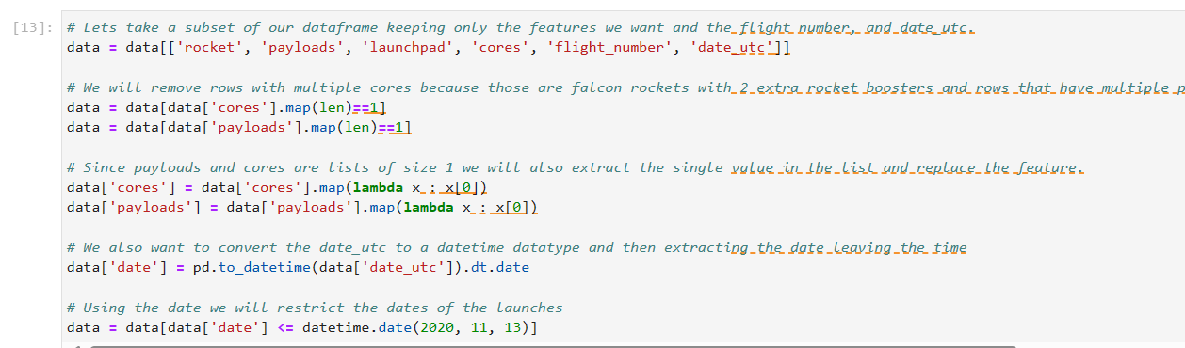
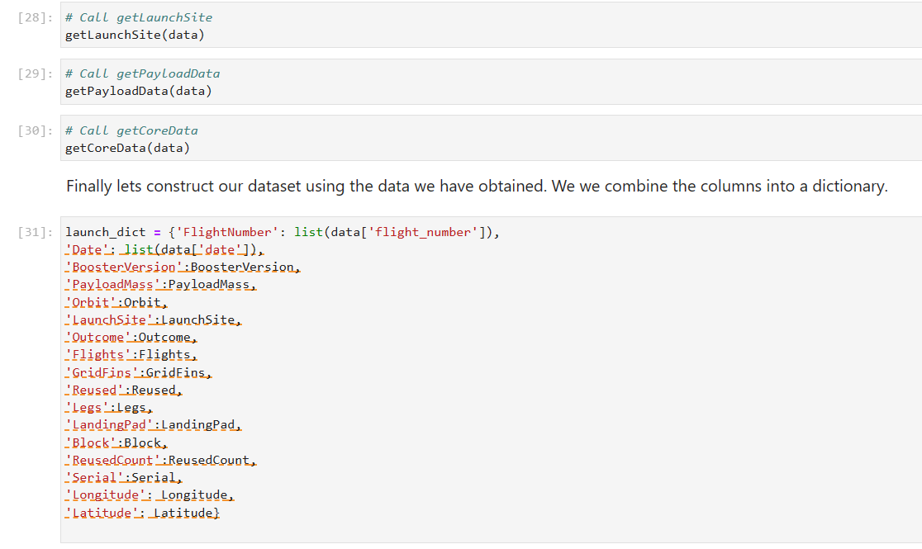
Data Collection – SpaceX API
A GET request was made to SpaceX REST API. The response was then converted to a json file which was then imported into a Pandas DataFrame
The data was then processed to obtain the relevant features such as rocket, payloads, lauchpad and so on. The dates were displayed in the correct format
For each feature, a list was created and defined functions were called to map the relevant features to the lists. These lists were then used to construct a dictionary that had keys matching the list of features
This dictionary was then converted to a Pandas Dataframe to store the final dataset. The dataframe was then filtered out to incorporate only Falcon 9 Launches

Slide 10
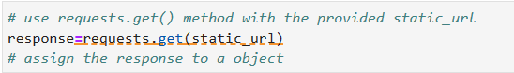
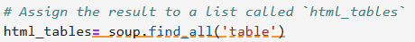
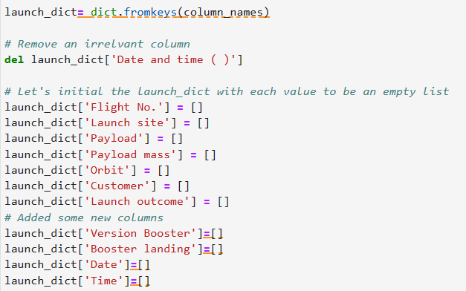
Data Collection - Scraping
1. Request the HTML page from the static URL through HTTP GET and store the response
2. A Beautiful Soup object is then created and http response is assigned to that object for further parsing and scraping
3. The data is analyzed and the html table tags is applied to the Beautiful Soup object to retrieve all relevant tables
4. A dictionary of column names is created. Custom functions are applied to retrieve data from tables and added to dictionary.
5. The dictionary of data is then converted to a pandas Dataframe for further processing and storage into a csv file

Slide 11
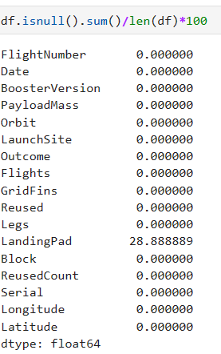
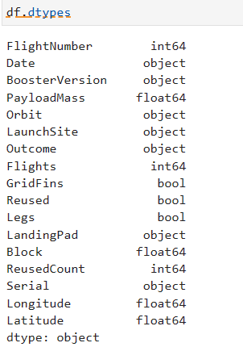
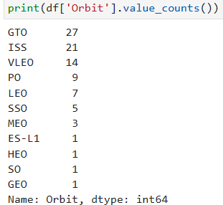
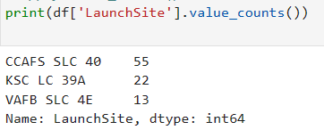
Data Wrangling
To obtain a good prediction later on, the dataset has to be cleaned and processed to provide the relevant intended and correct values
Here for each feature the percentage and number of missing values was calculated.
The type of data for each feature was determined
Launches are done from specific sites, and each launch is done to a specific orbit. For each launch the outcome is either a failure or success. To better understand the data, the value counts for the Orbit, Launch Sites and Outcome feature was calculated respectively.

Slide 12
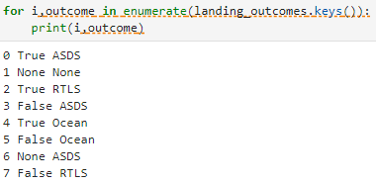
Data Wrangling (continued)
The following context gives an overview of launch sites, orbits and outcomes. True Ocean – the mission successfully landed in a specific ocean region.
False Ocean – the mission unsuccessfully landed in a specific ocean region.
True RTLS – the mission successfully landed on a ground pad.
False RTLS – the mission unsuccessfully landed on a ground pad.
True ASDS – the mission successfully landed on a drone ship.
False ASDS – the mission unsuccessfully landed on a drone ship.
None ASDS and None None – these indicate a failure to land.
Data Wrangling Process Overview:
To determine if a booster will successfully land, it's useful to create a binary column (1 for success, 0 for failure). This can be achieved through the following steps:
Define a set of unsuccessful (bad) outcomes, called bad_outcome.
Create a list, landing_class, where each element is 0 if the corresponding row in Outcome is in bad_outcome, otherwise it's 1.
Add a Class column to the DataFrame that contains the values from the landing_class list.
Export the DataFrame as a .csv file.

Slide 13
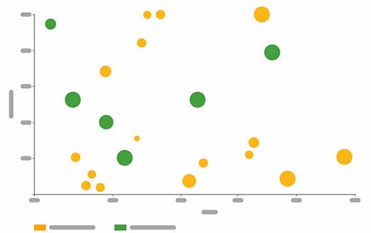
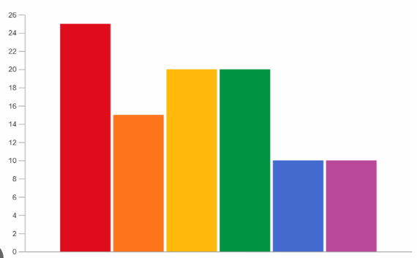
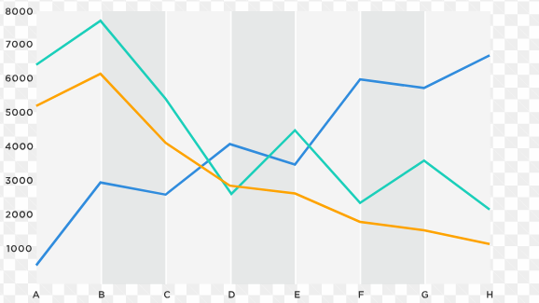
EDA with Data Visualization
Scatter Charts
Scatter charts are useful for observing relationships or correlations between two numerical variables. Scatter charts were used to view the relationship of: - Flight number and launch sites - Orbit type and flight number - Payload and Launch Site - Payload and Orbit Type
Bar Charts
Bar charts are used to compare numerical values with categorical variables. Depending on the data size, you can use either horizontal or vertical bar charts. Bar chart was used to visualize the relationship between: - Success Rate and Orbit type
Line charts
Line charts display numerical values on both axes and are typically used to illustrate changes in a variable over time.
A line chart was used to illustrate the relationship between: - Success Rate and Year (i.e. the launch success yearly trend)

Slide 14
EDA with SQL
To extract insights from the dataset, several SQL queries were executed. These queries aimed to:
Display the names of the unique launch sites in the space missions.
Retrieve 5 records where the launch sites start with the string 'CCA'.
Calculate the total payload mass carried by boosters launched by NASA (CRS).
Compute the average payload mass carried by the booster version F9 v1.1.
Identify the date of the first successful landing on a ground pad.
List the names of boosters that successfully landed on a drone ship with a payload mass between 4000 and 6000 kg.
Count the total number of successful and failed mission outcomes.
Identify the booster versions that carried the maximum payload mass.
List the failed landing outcomes on drone ships, along with their booster versions and launch site names for the year 2015.
Rank the landing outcomes (such as Failure on a drone ship or Success on a ground pad) between 2010-06-04 and 2017-03-20 in descending order.

Slide 15
Build an Interactive Map with Folium
The following steps were taken to visualize the launch data on an interactive map:
Marking Launch Sites on the Map: - Initialize the map using a Folium Map object.
- For each launch site, add a folium.Circle and a folium.Marker to the map.
Indicating Launch Success/Failure on the Map: - Given that many launches share the same coordinates, it’s practical to cluster them together.
- Before clustering, assign marker colors: green for successful launches (class = 1) and red for failed launches (class = 0).
- For each launch, add a folium.Marker to a MarkerCluster() object.
- Create an icon with a text label, setting the icon color to the previously determined marker color.
Calculating Distances Between Launch Sites and Their Proximities: - To analyze the proximity of launch sites, calculate the distances between points using their latitude and longitude values.
- Mark a point using the latitude and longitude values and create a folium.Marker object to display the distance.
- To show the distance line between two points, draw a folium.PolyLine and add it to the map.

Slide 16
Build a Dashboard with Plotly Dash
The following visualizations were incorporated into a Plotly Dash dashboard for an interactive exploration of the data:
Pie Chart (px.pie()):
Displays the total number of successful launches per site.
Clearly highlights which sites have the highest success rates.
Includes a filter option using a dcc.Dropdown() to view the success/failure ratio for individual sites.
Scatter Plot (px.scatter()):
Illustrates the correlation between the outcome (success or failure) and payload mass (kg).
Features a RangeSlider() to filter the data by different payload mass ranges.
Additionally, includes a filter to sort the data by booster version.

Slide 17
Predictive Analysis (Classification)
For the purpose of this exercise, multiple classifications were built and the best performing one was selected for prediction
Model Creation
To prepare the dataset for model development, the following steps were undertaken:
Load the Dataset:
Import the dataset for analysis.
Data Transformation:
Perform necessary data transformations, including standardization and preprocessing.
Split Data:
Divide the data into training and test sets using train_test_split().
Algorithm Selection:
Determine the most suitable machine learning algorithms for the task.
Model Training:
For each selected algorithm:
Create a GridSearchCV object along with a dictionary of parameters.
Fit the GridSearchCV object to these parameters.
Train the model using the training dataset.
Evaluation of model
For each selected algorithm, perform the following steps using the GridSearchCV output:
Evaluate Tuned Hyperparameters:
Retrieve and examine the best hyperparameters (best_params_).
Assess Accuracy:
Check the accuracy scores (score and best_score_).
Analyze Confusion Matrix:
Plot and review the Confusion Matrix to evaluate model performance.
Choosing best model
Evaluate the accuracy scores of all the selected algorithms.
The model exhibiting the highest accuracy score is identified as the top-performing model

Slide 18
Results
Exploratory data analysis results
Interactive analytics demo in screenshots
Predictive analysis results

Slide 19

Section 2

Slide 20
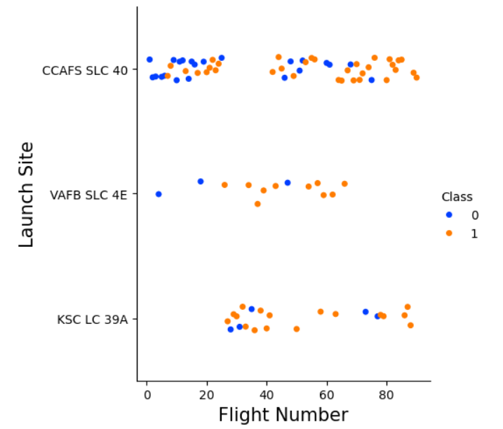
Flight Number vs. Launch Site
The scatter plot comparing Launch Site and Flight Number reveals the following insights:
Success rates at a launch site improve as the number of flights increases.
Early flights (flight numbers below 30) predominantly launched from CCAFS SLC 40 were mostly unsuccessful.
VAFB SLC 4E also exhibited a similar pattern, with initial flights showing lower success rates.
KSC LC 39A did not have early flights, resulting in higher success rates for launches from this site.
After reaching a flight number of approximately 30, there is a notable increase in successful landings (Class = 1).

Slide 21
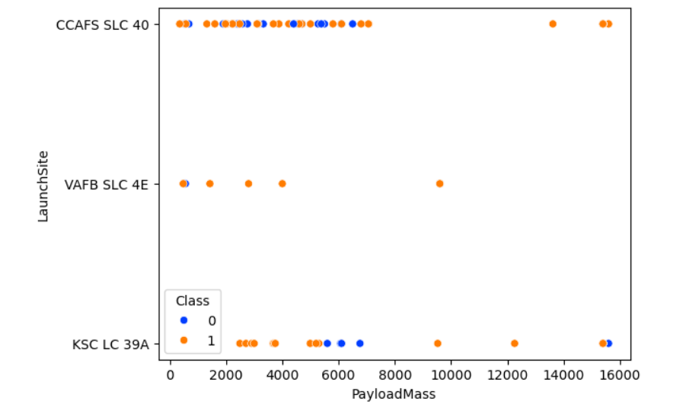
Payload vs. Launch Site
The scatter plot comparing Launch Site and Payload Mass indicates the following points:
For payloads exceeding approximately 7000 kg, unsuccessful landings are rare, though data for these heavier launches is sparse.
There is no apparent relationship between payload mass and the success rate at any specific launch site.
All launch sites handled a range of payload masses, with CCAFS SLC 40 typically launching lighter payloads, although there are some exceptions.

Slide 22
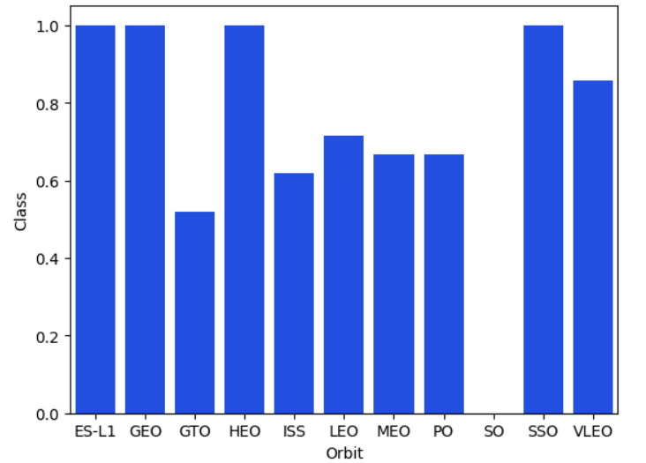
Success Rate vs. Orbit Type
The bar chart depicting Success Rate versus Orbit Type reveals the following orbits with a perfect (100%) success rate:
ES-L1 (Earth-Sun First Lagrangian Point)
GEO (Geostationary Orbit)
HEO (High Earth Orbit)
SSO (Sun-synchronous Orbit)
Conversely, the orbit with the lowest success rate (0%) is:
SO (Heliocentric Orbit)

Slide 23
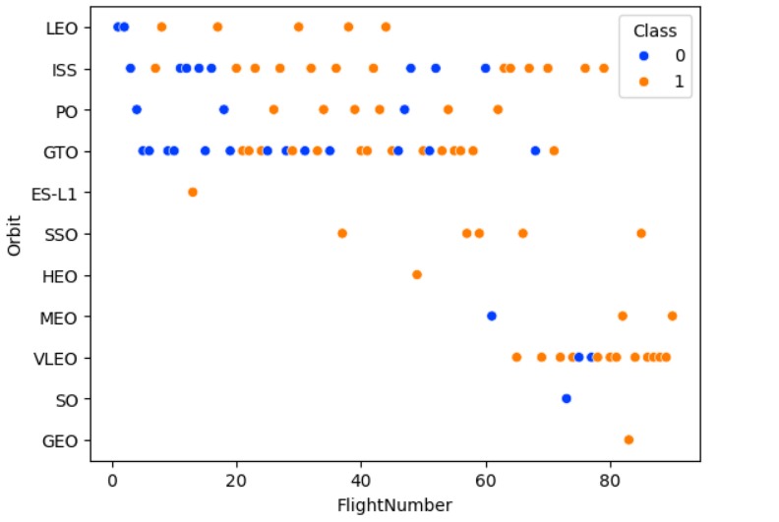
Flight Number vs. Orbit Type
This scatter plot of Orbit Type versus Flight Number reveals several insights not shown in previous plots:
The perfect (100%) success rates for GEO, HEO, and ES-L1 orbits are due to each having only one flight.
The 100% success rate for SSO is notable, with five successful flights.
There is minimal correlation between Flight Number and Success Rate for GTO.
In general, the success rate improves as the Flight Number increases. This trend is especially pronounced for LEO, where failures occurred only during the early flights with lower flight numbers.

Slide 24
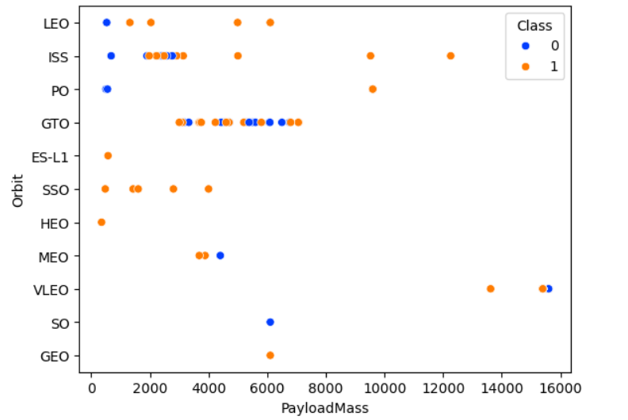
Payload vs. Orbit Type
This scatter plot of Orbit Type versus Payload Mass indicates that:
PO (despite limited data points), ISS, and LEO orbits achieve higher success rates with heavier payloads.
For GTO, the link between payload mass and success rate remains ambiguous.
VLEO (Very Low Earth Orbit) launches typically carry heavier payloads, which is logically expected.

Slide 25
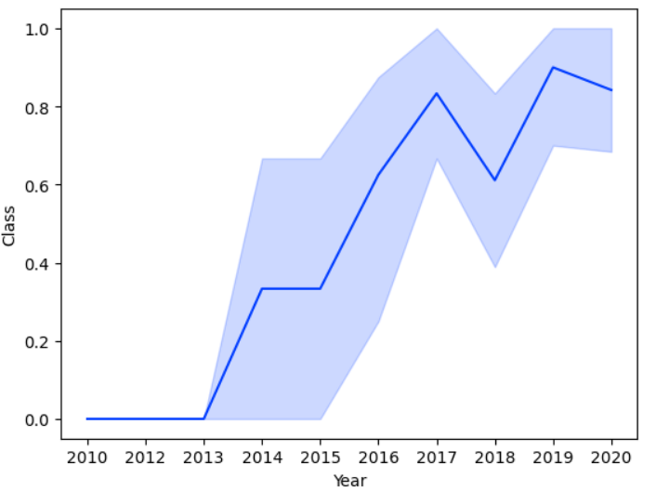
Launch Success Yearly Trend
The line chart of yearly average success rate shows that:
Between 2010 and 2013, all landings were unsuccessful (as the success rate is 0).
After 2013, the success rate generally increased, despite small dips in 2018 and 2020.
After 2016, there was always a greater than 50% chance of success.

Slide 26
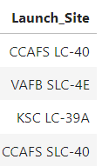
All Launch Site Names
Here the word DISTINCT is used to select only the unique names of lauch sites

Slide 27
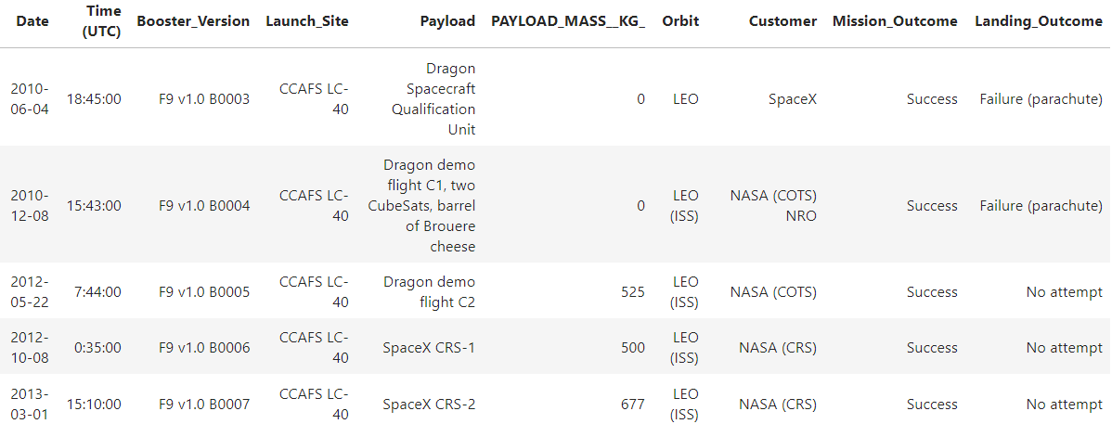
Launch Site Names Begin with 'CCA'
Here the keyword LIKE is used to find pattern of CCA in Launch Sites and the keyword LIMIT is used to show only the 5 top records

Slide 28
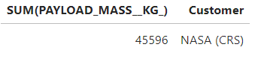
Total Payload Mass
The WHERE clause is used to check for only NASA (CRS) customers while the SUM does a summation of all the Payload Mass of the NASA customers
The group by clause is used to group the sum by customers

Slide 29
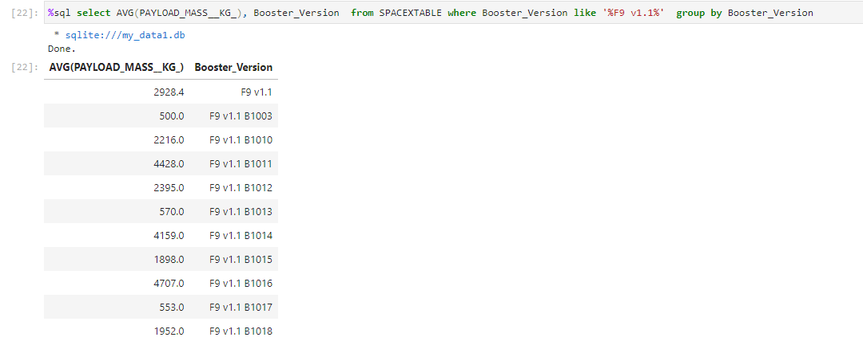
Average Payload Mass by F9 v1.1
To obtain the average payload mass for the F9 v1.1 booster version, the AVG keyword is used in conjunction with the WHERE clause to give the desired result.

Slide 30
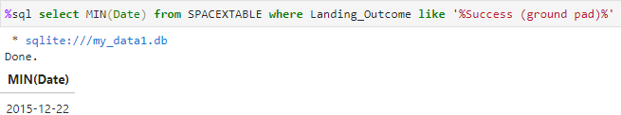
First Successful Ground Landing Date
The MIN keyword is used here to find the earliest date and the LIKE clause is used to limit the results to Success (ground pad) Landing outcomes

Slide 31
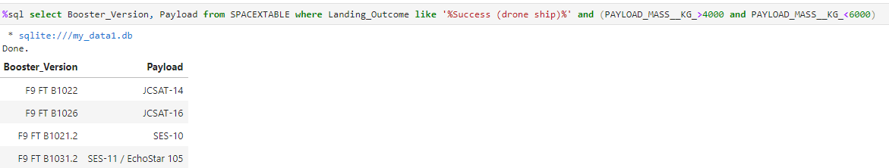
Successful Drone Ship Landing with Payload between 4000 and 6000
Here a condition of PAYLOAD_MASS_KG > 4000 and PAYLOAD_MASS_KG <6000 is used to find the corresponding data for Landing outcome of Success (drone ship)

Slide 32
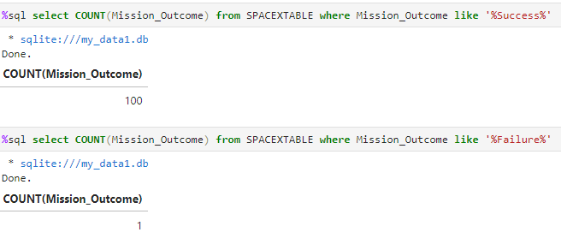
Total Number of Successful and Failure Mission Outcomes
Here there are 2 queries: one for success and one for failure
A count method was used to check for both success and failure.

Slide 33
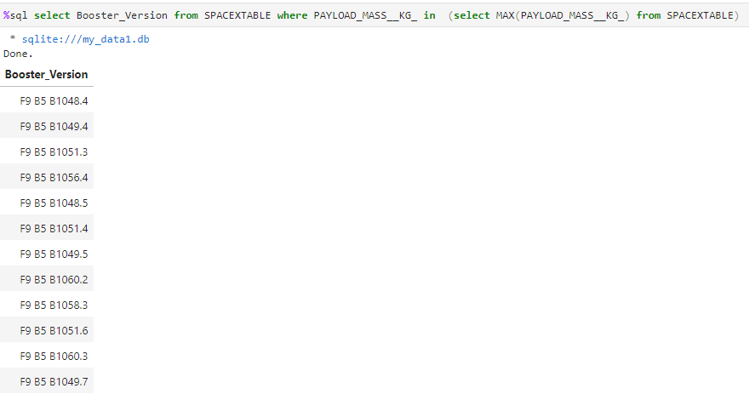
Boosters Carried Maximum Payload
Here a subquery has been used. The inner query uses MAX to get the highest payload mass and the outer queries uses IN to check for every booster version that has payload mass as the max payload mass

Slide 34
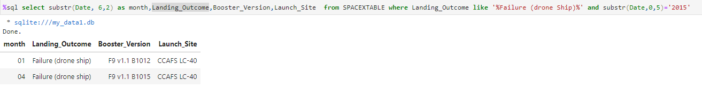
2015 Launch Records
A combination of WHERE clause and AND logical operator is used here. The WHERE clause is used to check the different criteria.

Slide 35
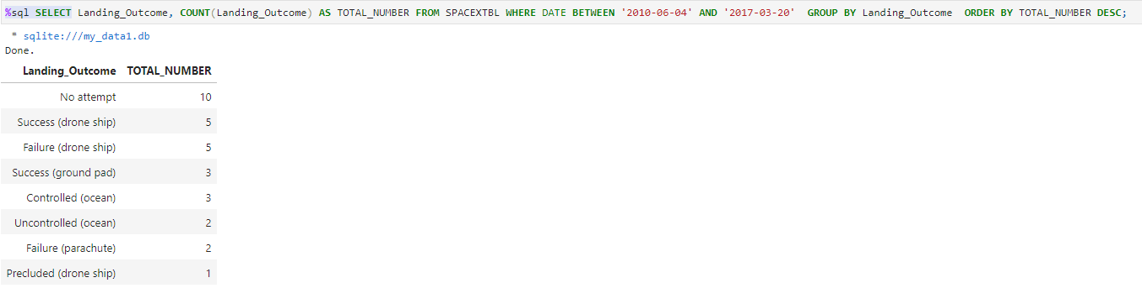
Rank Landing Outcomes Between 2010-06-04 and 2017-03-20
Here the COUNT aggregate is used to calculate the total number of landing outcomes, and a BETWEEN statement is introduced to match the date criteria.
Since an aggregate function was used, a group by statement is use together with an ordering by descending statement

Slide 36

Section 3

Slide 37
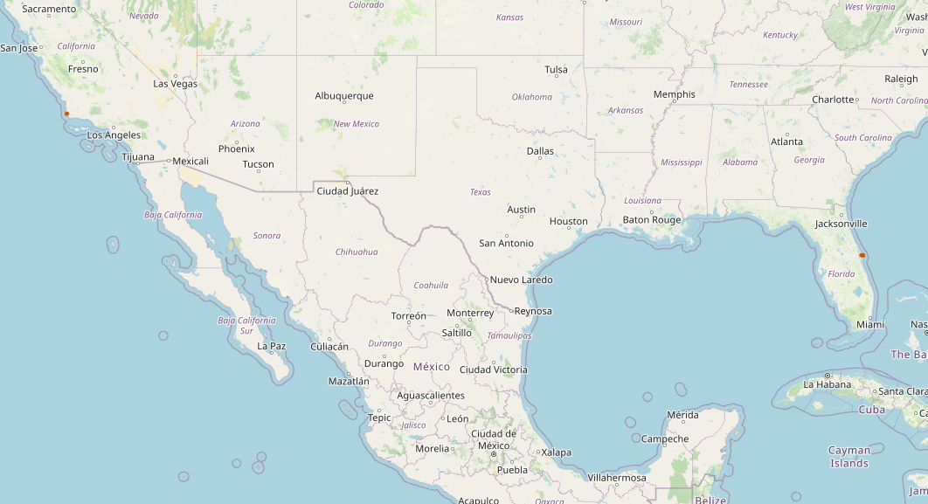
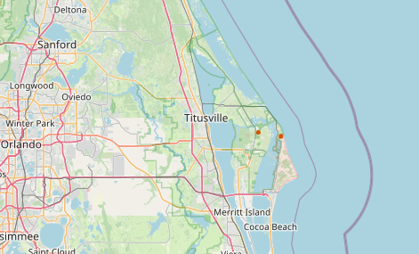
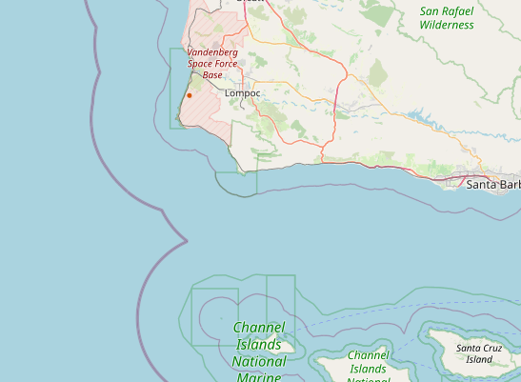
Overview of location of the 3 launch sites
These are the screenshots of the launch sites magnified and birds view and we can conclude that all the sites are located at the coastal regions

Slide 38
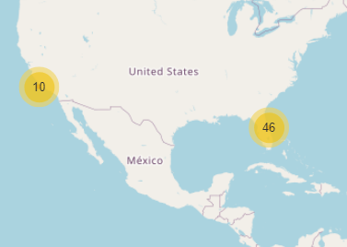
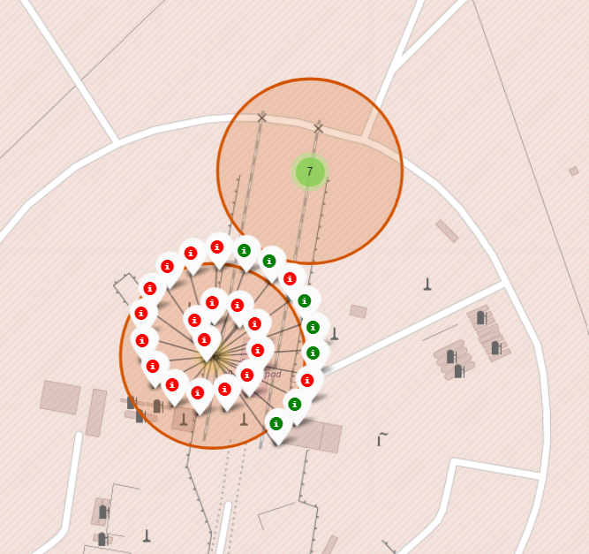
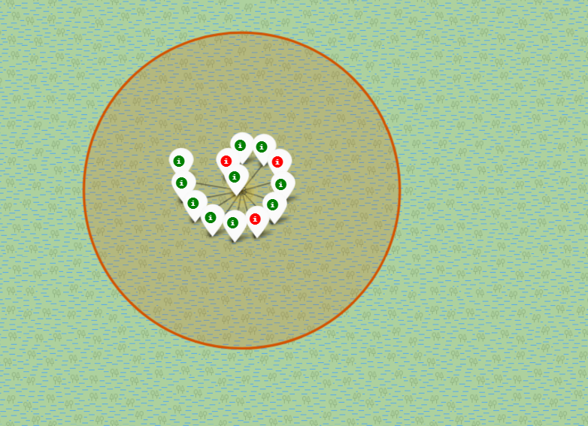
Indicators for successful and failed launches
There are multiple launches and they have been grouped into clusters. The green ones represent the successful launches while the red ones represent the unsuccessful ones.

Slide 39
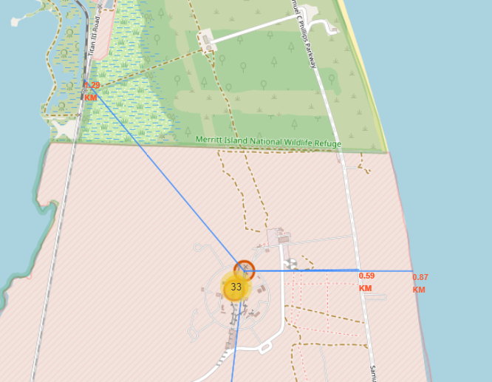
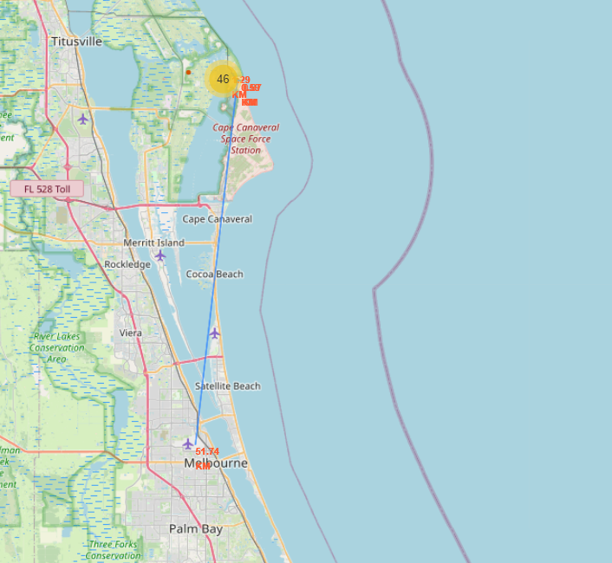
Proximities of the CCAFAS SLC-40 launch site
Here we can conclude the following:
The launch sites are close to coastline with the latter being only 0.87 km away
The launch sites are close to highways with the nearest highway being 0.59 km away
The nearest railway is 1.29 km away
The launch sites are distant from cities with the specified CCAFS SLC-40 being 51.74 km away

Slide 40

Section 4

Slide 41
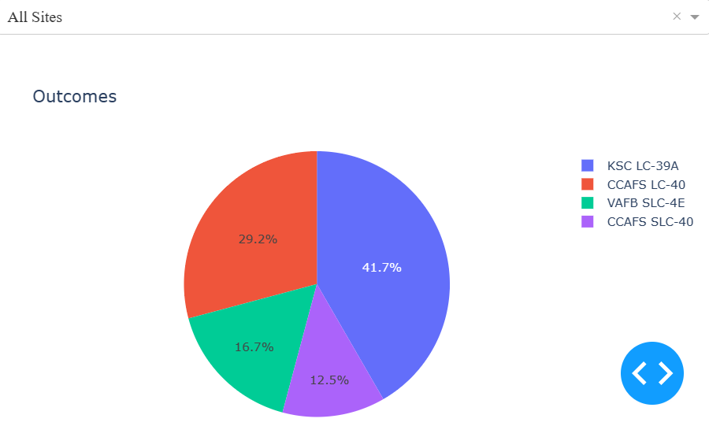
The success launch rate for all sites
Here we can conclude that the booster that had the highest success rate is KSC LC -39A while the one that had the lowest success rate is CCAFS -SLC-40

Slide 42
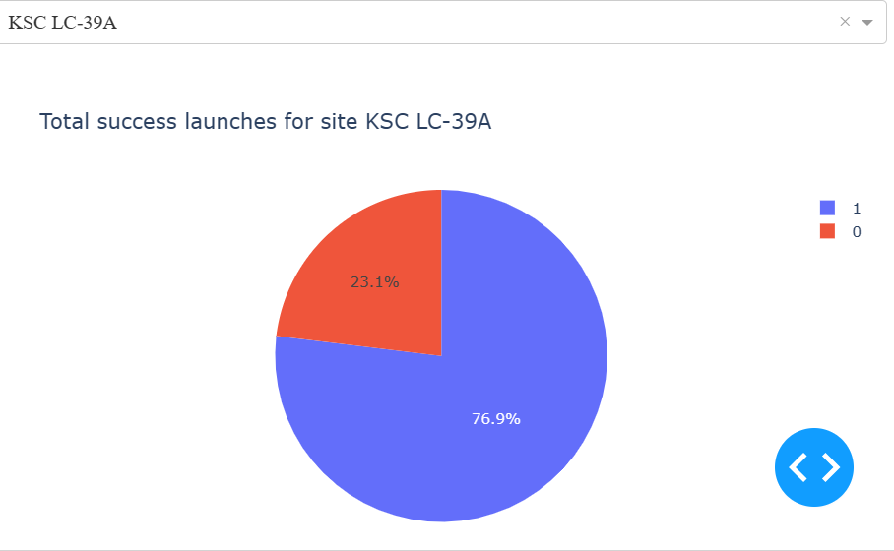
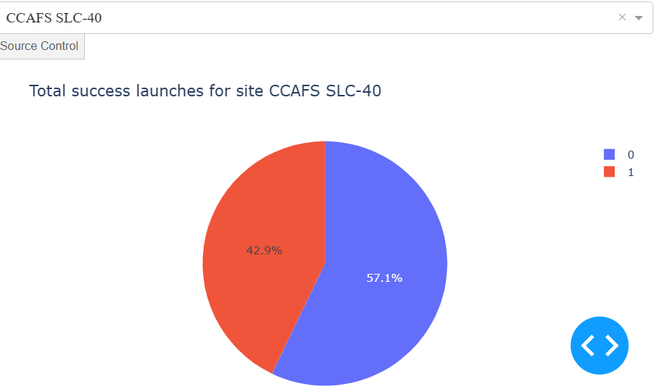
Percentage of success and failure for lowest and highest successes
The booster with the highest launch success rate is KSC LC-39A while the booster with the lowest launch success rate is CCAFS SLC-40

Slide 43
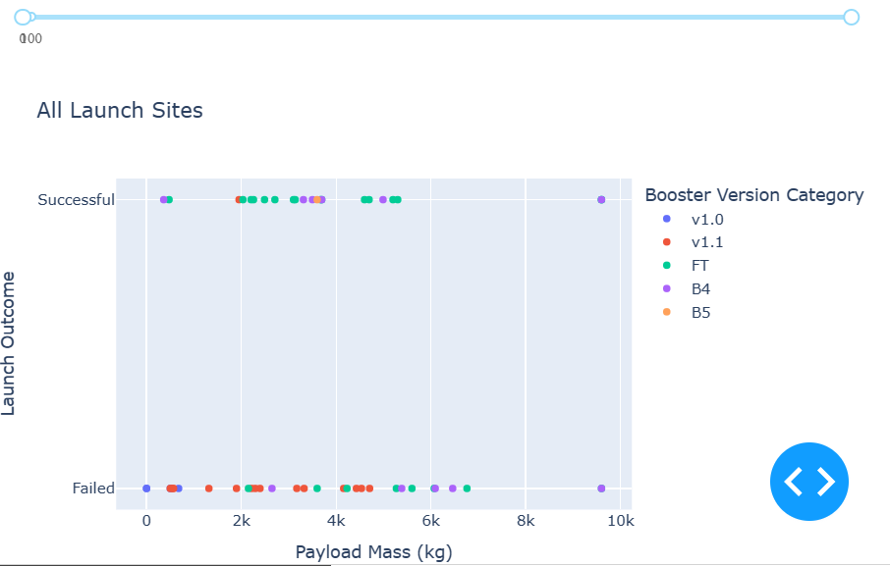
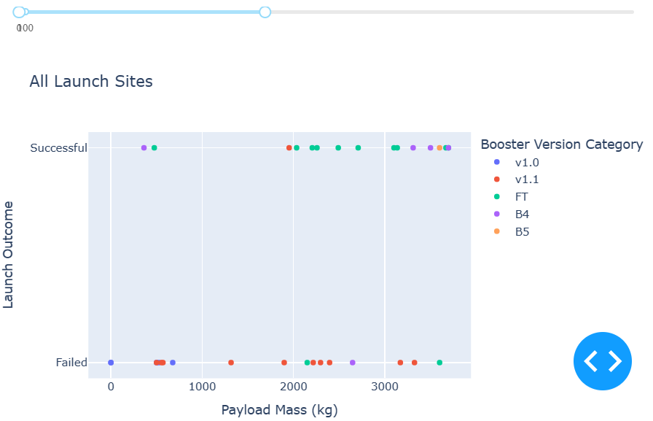
Correlation between payload mass and landing outcomes for different boosters
Here we can conclude that there is a correlation between the landing outcomes and the payload for different ranges
FT Booster for example has a higher success range between the range 2000 and 4000 kg

Slide 44

Section 5

Slide 45
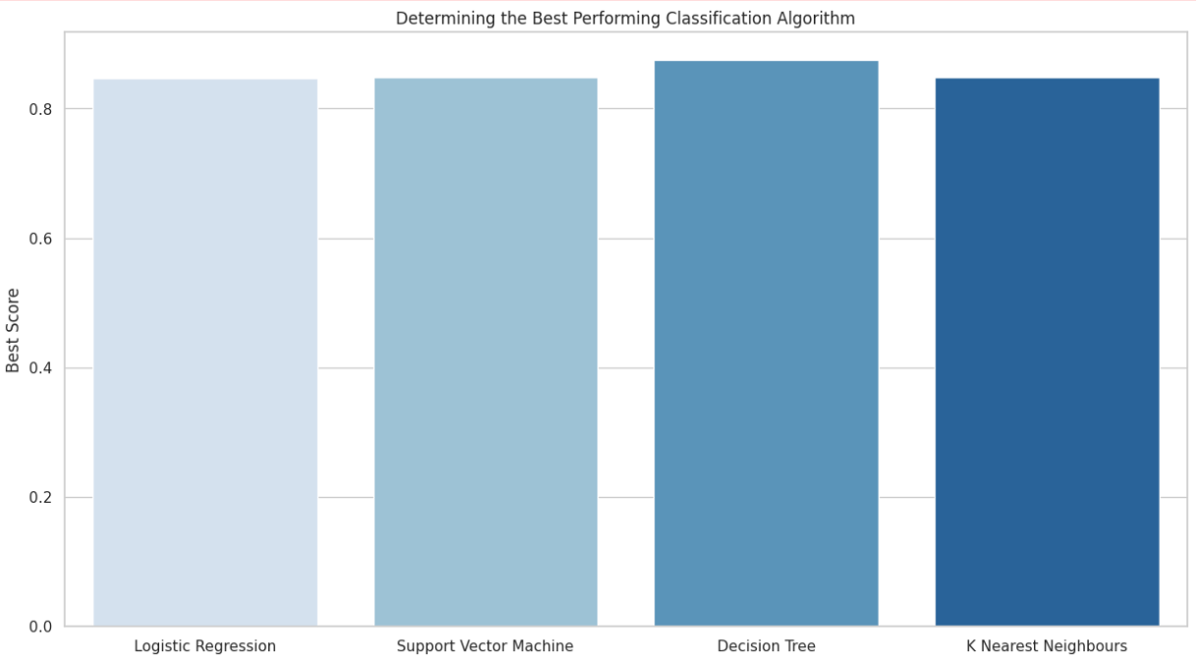
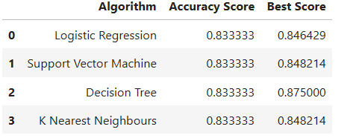
Classification Accuracy
Plotting the accuracy score vs the classifiers we can see that the Decision tree has the highest score and hence is the best classifier

Slide 46
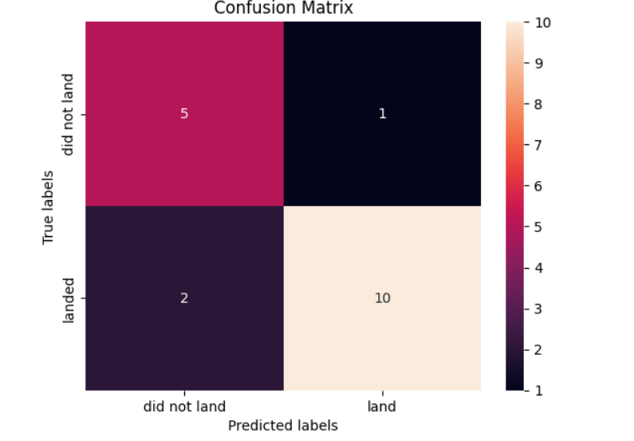
Confusion Matrix
Out of the 18 predictions, 5 out of 6 true negatives were predicted and 10 out of 12 true positives were predicted
Hence we can conclude that from the confusion matrix the Decision tree is the best classifier

Slide 47
Conclusions
The success rate at a launch site improves as the number of flights increases, with early flights often failing. Increased experience leads to higher success rates.
From 2010 to 2013, all landings failed, resulting in a 0% success rate during that period.
Post-2013, the success rate generally trended upwards, although there were minor declines in 2018 and 2020.
Since 2016, the likelihood of a successful landing has consistently exceeded 50%.
The orbit types ES-L1, GEO, HEO, and SSO all have a perfect success rate of 100%.| The 100% success rate for GEO, HEO, and ES-L1 orbits is due to having only one flight each into these orbits. The 100% success rate for SSO is particularly notable, with five successful flights. The orbit types PO, ISS, and LEO demonstrate higher success rates with heavier payloads. VLEO (Very Low Earth Orbit) launches also involve heavier payloads, which aligns with expectations.
Launch site KSC LC-39 A achieved the highest number of successful launches, accounting for 41.7% of all successful launches. It also boasted the highest success rate, with 76.9% of its launches being successful.
The success rate for large payloads (over 4000kg) is lower compared to lighter payloads.
The Decision Tree model is the top-performing classification model, achieving an accuracy of 94.44%.

Slide 48


